Slide 1
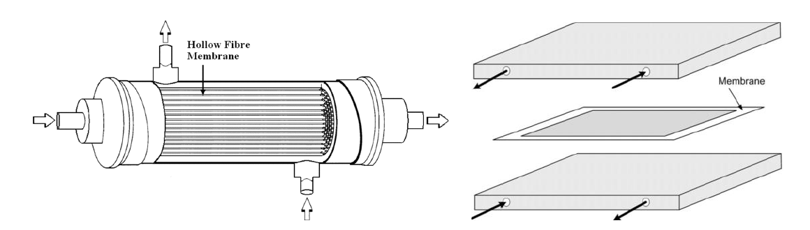
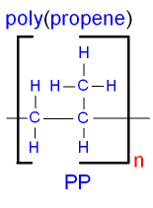
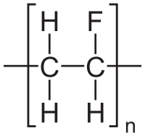
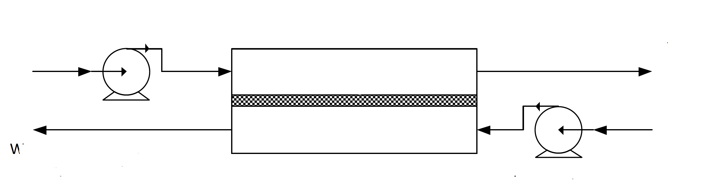
Using Membrane Distillation To Purify Waste Water
How effective is polypropene membrane in comparison to polyvinylidene fluoride membrane in removing heavy metal ions in particular lead from wastewater produced by coal-powered stations?
What is membrane distillation?
It is a thermal, membrane-based separation process that utilizes differences in vapor pressure to permeate water through a macro-porous membrane and reject other non-volatile constituents present in the influent water. The driving force in this process is very different from other membrane based separation processes because it depends on the difference in vapor pressure across the membrane rather than an applied absolute pressure difference, a concentration gradient or an electrical potential gradient, which drives mass transfer through a membrane.
Polyvinyl fluoride
Method
Prepare solutions with fixed concentration of lead to mimic the wastewater treatment process.
Use polypropene membranes and polyvinylidene fluoride membranes to purify water by membrane distillation.
Set up the controlled variables, namely, time, temperature, pressure and concentration of lead.
Use atomic adsorption to measure the concentration of lead in the processed water.
Compare the concentrations of lead before and after the experiment.
Repeat the above steps at least three times to avoid random errors in the experiment.
The type of membrane that removes a larger amount of lead is more effective.
Feed Pump
Permeate Pump
References
Camacho L. M, Dumee L, Zhang J, Li J, Duke M, Gomez J, Gray S. (2013). Advances in Membrane Distillation for Water Desalination and Purification Applications. Water, Vol. 5 Issue 1, 94-196. doi:10.3390/w5010094
Department Of Defense. (2003) Standard Test Methods for Lead in Water. (ASTM D-3559), Washington, DC: U.S. Government Printing Office.

